Slide 1
API Sources
Ted Kwartler

Slide 2

What is an API?
“Application Program Interface”
Clearly defined methods of communication between various software components.

Slide 3
Two formats
JSON- Javascript Object Notation
Similar to R but used to make interactive objects in web browsers.
Respond in XML or JSON
Ask a question

Slide 4


Your phone doesn’t have every map in the world.
“Your phone requests information from the maps API services to render the information.

Slide 5
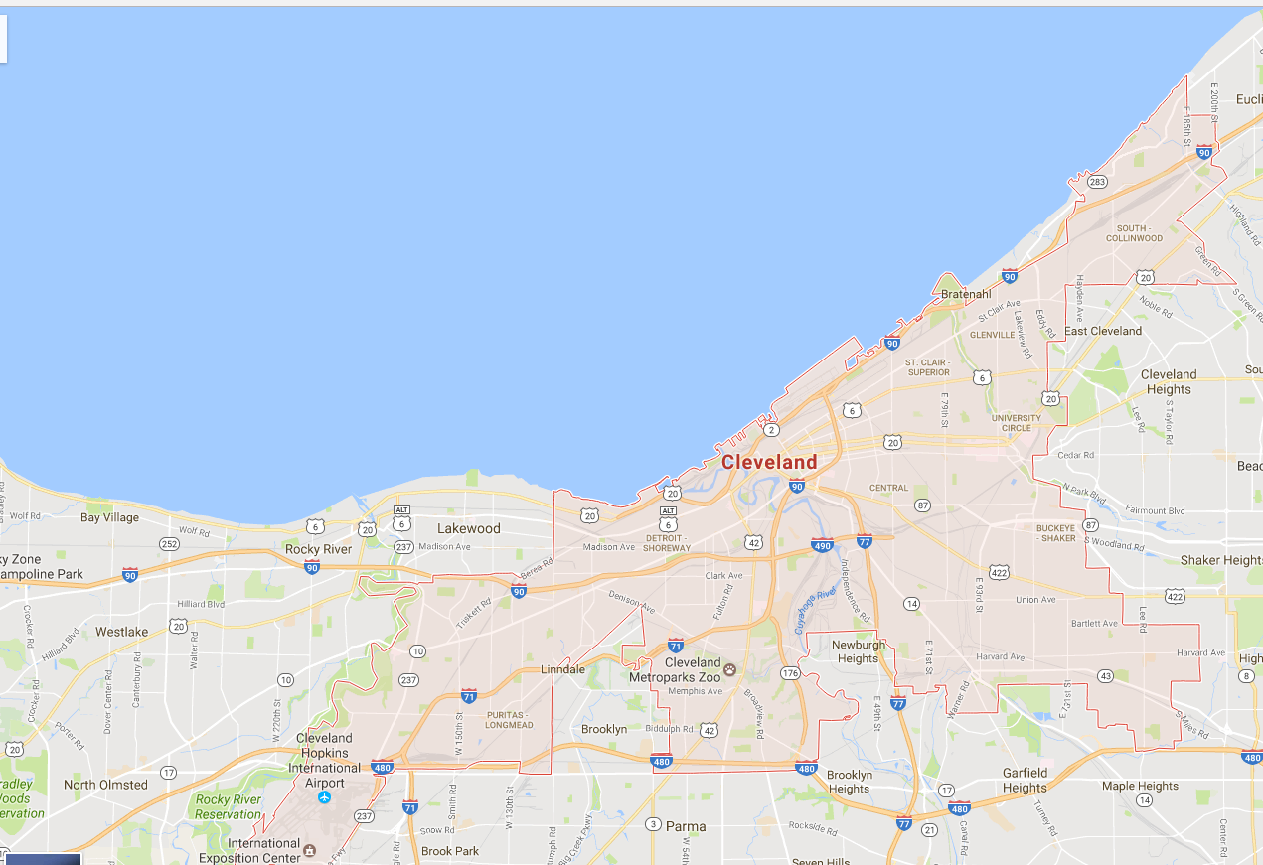
Your phone doesn’t have every map in the world.
www.google.com/maps/place/Cleveland,+OH/@41.4951143,-81.8462865,11z
Google Maps API Services include
Geocoding
Base map “tiles”
Basic Geographic Info

Slide 6
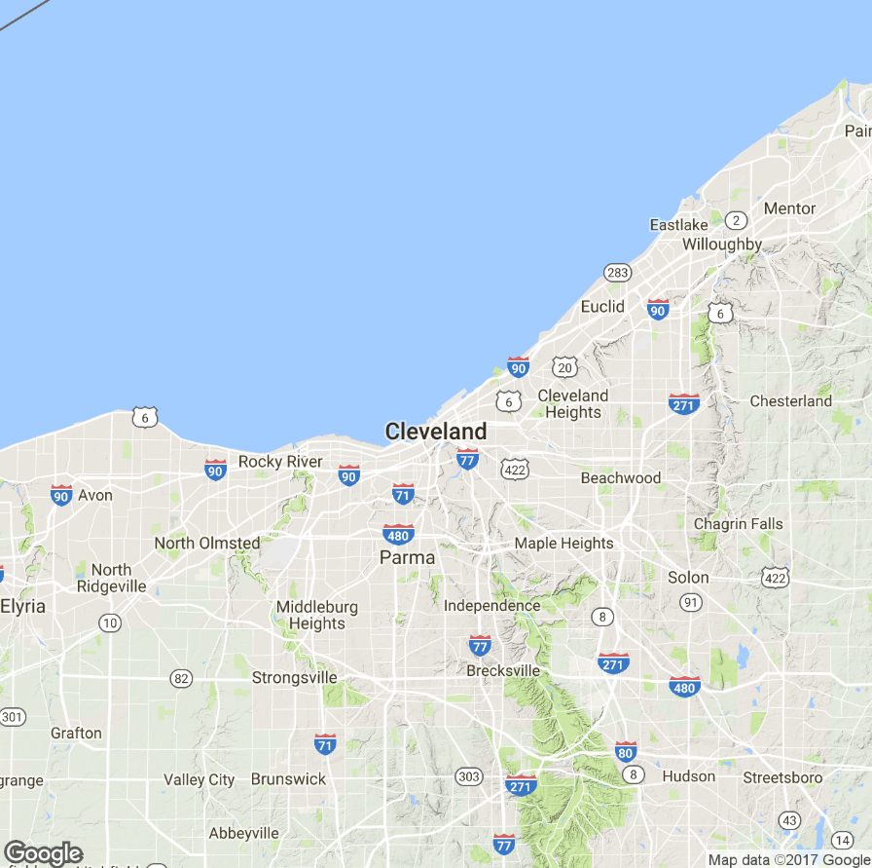
APIs are behind many of the sites you use everyday.
Static Map API
Static images are loaded as tiles underneath allowing you to scroll and navigate in your browser.

Slide 7
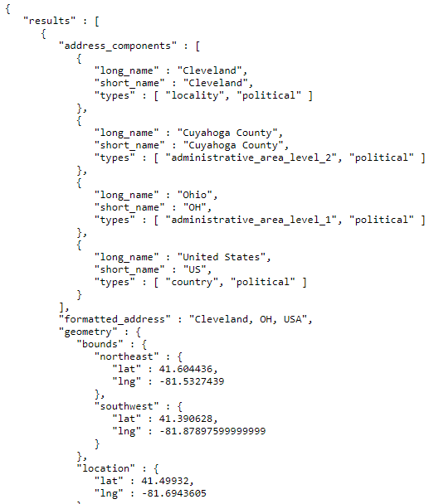
APIs are behind many of the sites you use everyday.
JSON Information API
On top of the tiles, more information is needed including the geo-political information and coordinates for the “bounding box”

Slide 8

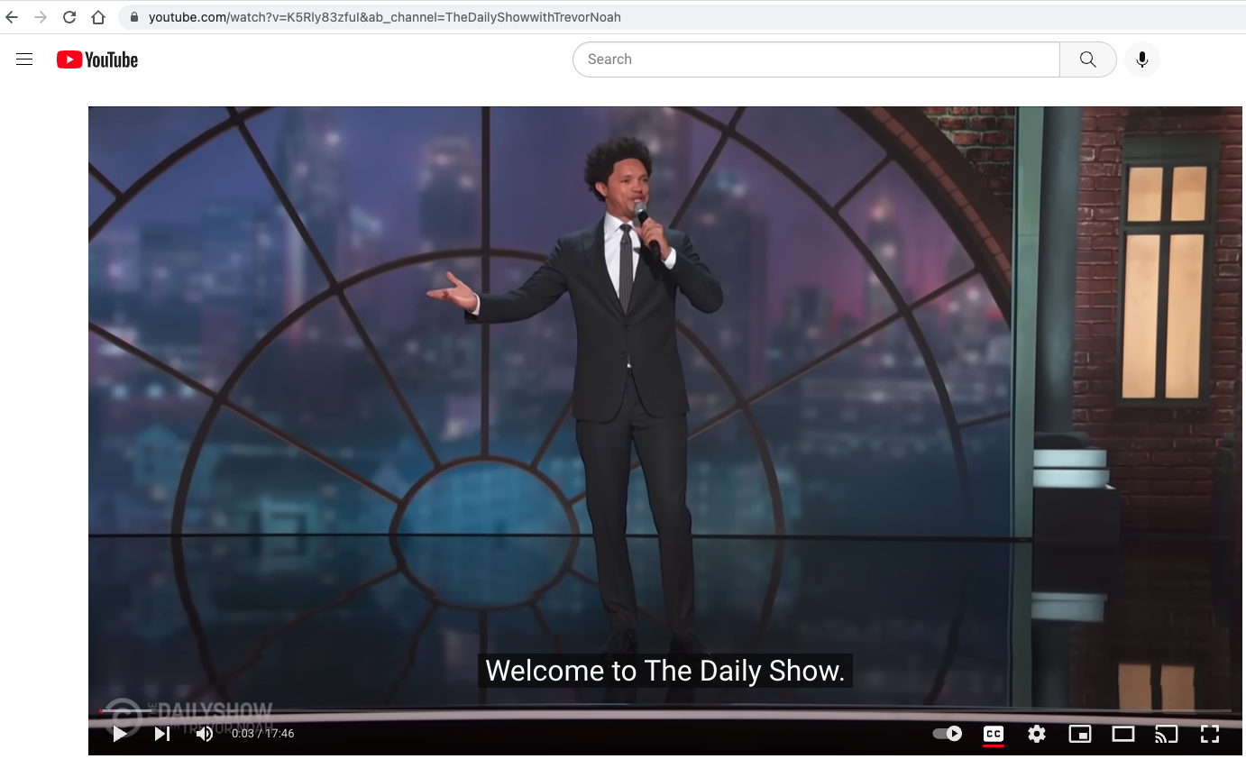
If you know where to look, you can access APIs for data!
If the video has closed captioning, let’s grab the text by clicking “cc”
https://www.youtube.com/watch?v=K5Rly83zfuI&ab_channel=TheDailyShowwithTrevorNoah

Slide 9

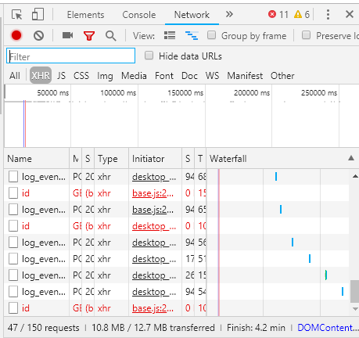
In chrome access the developer console.
While the video is playing, press F12 & reload the page.

Slide 10
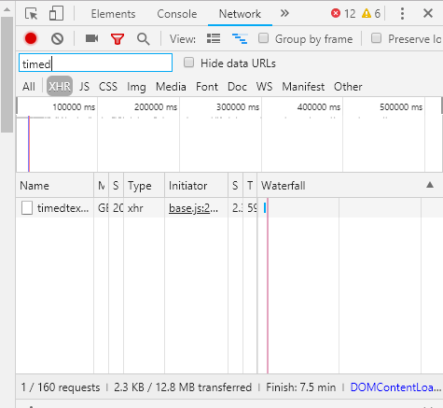
Click XHR and search for “timed” as in timedtext.
Right click on the request name and select “open in new tab”

Slide 11
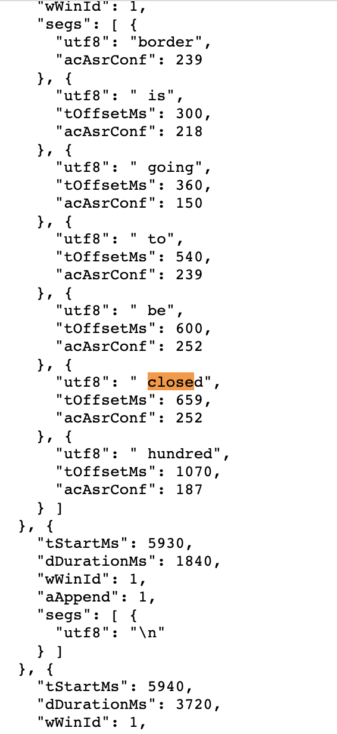
Closed Caption Data is in JSON

Slide 12
Let’s Practice…
F_youtubeAPI_example.R

Slide 13
Other Straightforward APIs to Explore
If you work with social media data (requires signing up)
https://pipl.com/dev/demo
Sources of APIs to explore
Sign up at https://newsapi.org/
https://projects.fivethirtyeight.com/trump-approval-ratings/
https://projects.fivethirtyeight.com/biden-approval-rating/historical-approval.json
https://www.programmableweb.com/apis/directory
https://github.com/toddmotto/public-apis

Slide 14
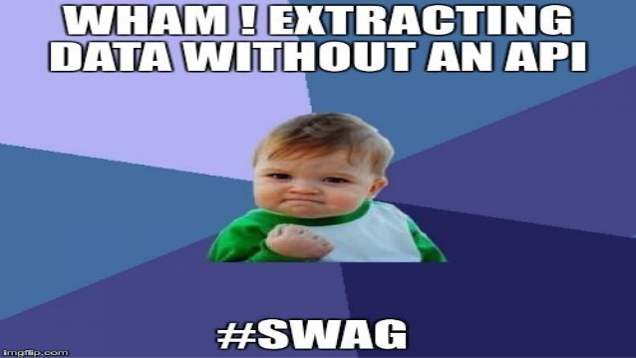
Questionable Practice
Websites don’t like you taking information for various reasons. Always respect terms of service and any blocking software.

Slide 15
Web-scraping
Everything in a webpage is “client” side (interpreted by your computer), therefore you can get anything you see.
Each scrape is literally custom software
Webpages have different styles, object names, and complexity…always check for an API first.

Slide 16
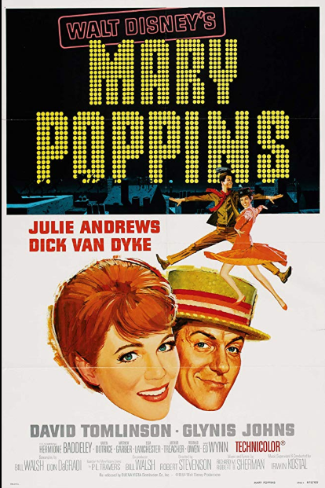
Web Scraping Example
IMDB.com
Internet Movie Database
Owned by Amazon.com
Realistically messy but doesn’t stop scraping

Slide 17
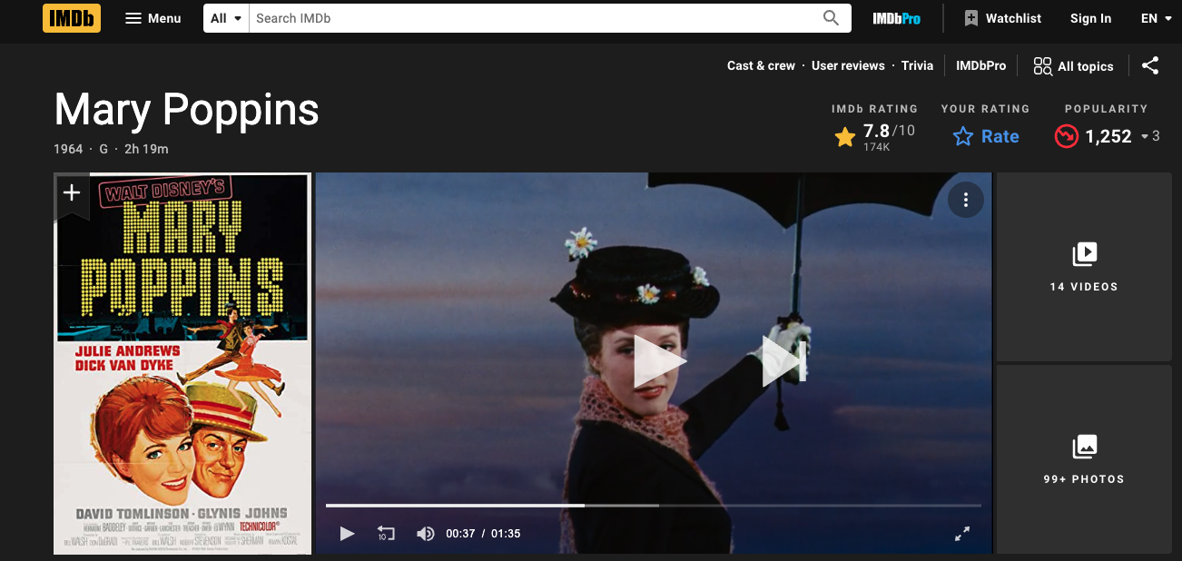
Getting some data
G_webScraping.R

Slide 18
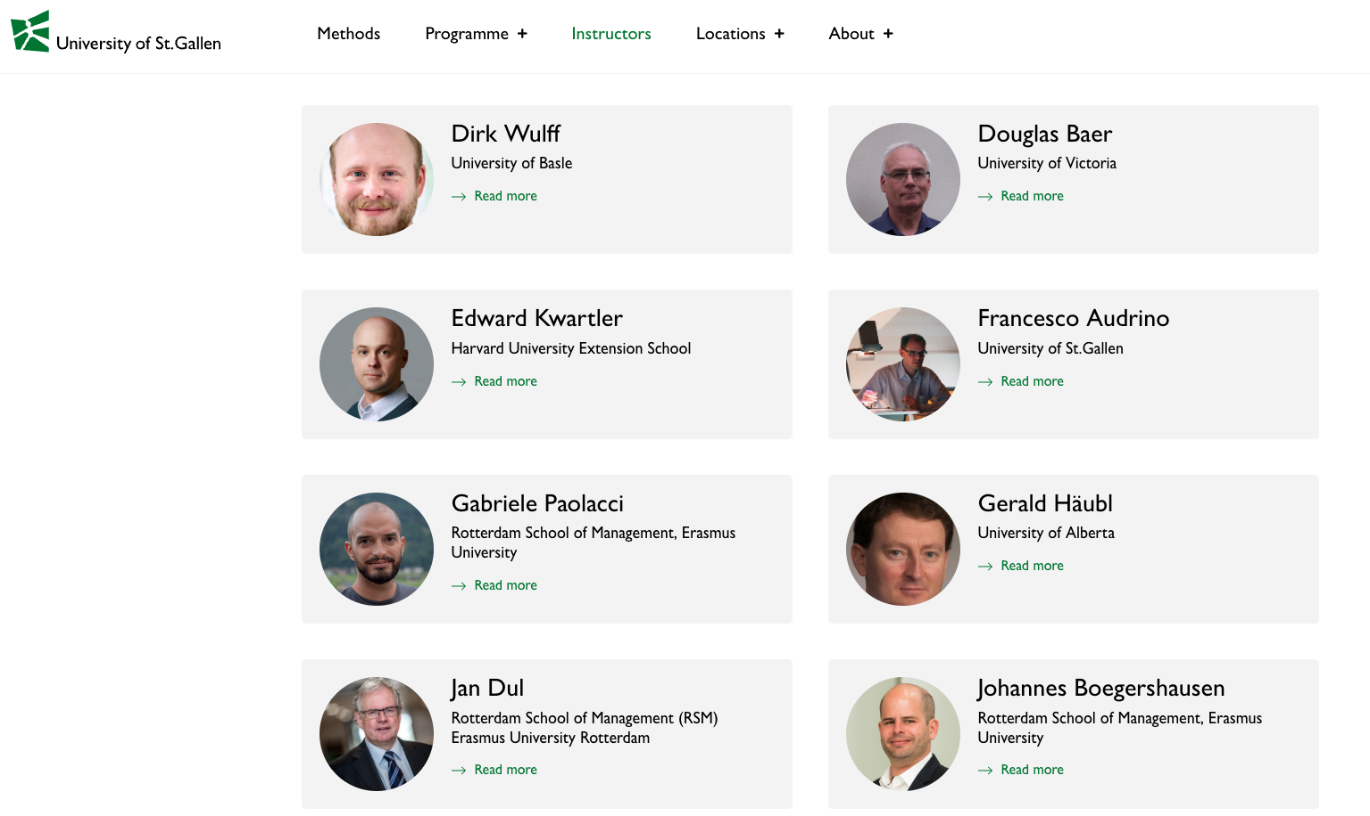
Let’s get the dirt on University of St Gallen profs.
Open a “headless” browser to the instructor page. Programatically find all appropriate URLS which is represented by each picture.

Slide 19
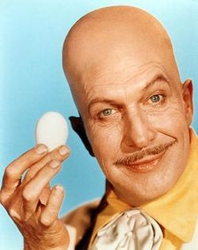
After ID’ing the links go to each bio
Open a “headless” browser to the instructor page. Find all appropriate URLS which is represented by each picture.
Loop through all ID’ed URLs to get the bio of each professor.
…
…

Slide 20
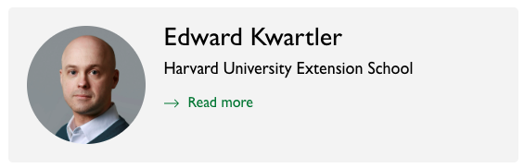
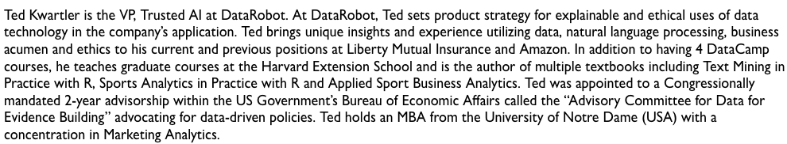
Let’s get the dirt on our profs.
H_webScraping_multipleURLS.R
Page1 Get the “Read more” Link
Open a “headless” browser to the instructor page. Find all appropriate URLS which is represented by each picture.
Loop through all ID’ed URLs to get the bio of each professor.
Extract the bio text from each page and organize
Navigate to Page 2 & scrape the text

